Slide 1

Redux Origins
Israel Zablianov Frontend developer @ Premium Aug, 2022

Slide 2


MVC
Flux
Redux
C
V
M

Slide 3
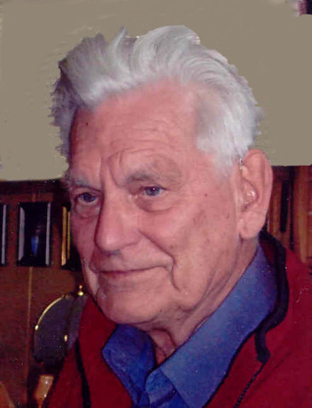
MVC - Overview
In 1979, Trygve Reenskaug introduced to the world the MVC pattern.
A software architectural pattern that separates an application into three main logical components - Model View Controller.
Data synchronization and updates are handled by the observer pattern.
Trygve Reenskaug

Slide 4
MVC - Overview
Model
View
Controller
Responsible for managing application domain data.
Responsible for rendering a UI presentation of the model.
Responsible for handling user input. e.g. proccesing the data recivied in some input and passing it to the model.

Slide 5
MVC – Architecture
Model
Controller updates Model’s data
View subscribes to
the model changes
Controller
View
The controller subscribes
to the view events

Slide 6

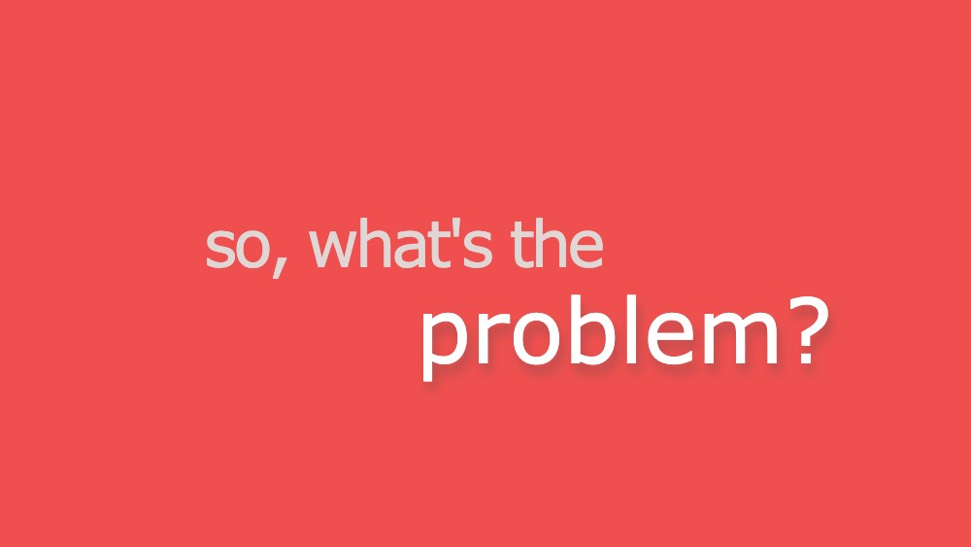
What’s the catch

Slide 7
MVC Doesn’t Scale
According to Facebook, MVC is based on the concept of ‘bidirectional data flow’ also known as ‘two way data binding’ and therefore -
MVC doesn’t scale

Slide 8
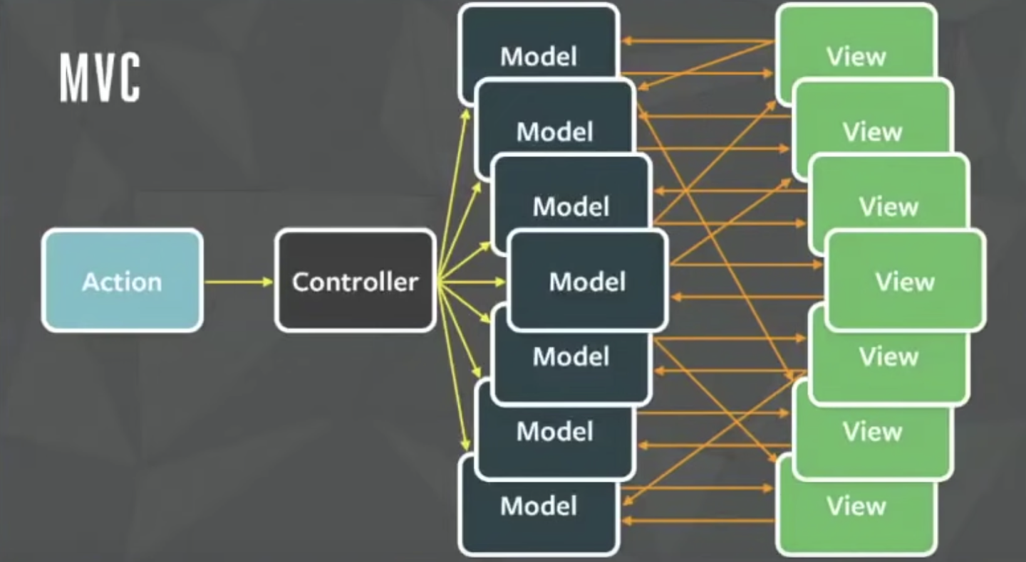
Why bidirectional flow is not scalable?
An architecture diagram for one of Facebook’s more complex interfaces.
Can you explain the data flow?
Can you tell if Is there’s an infinite loop here?
Hacker Way: Rethinking Web App Development at Facebook

Slide 9

Facebook Chat Bug
The unseen count was showing even if there were no unseen messages.
As new features are added to the chat, this bug has returned with a new edge case.
A system like that makes it difficult to keep track of the data flow and onboard new members.

Slide 10


Flux
“Flux is the application architecture that Facebook uses for building client-side web applications.”

Slide 11
Flux - An Alternative to MVC
In 2014, during the Hacker-Way conference, Facebook introduced Flux architecture - an alternative to MVC.
The main concept of flux is unidirectional data flow.
Data synchronization and updates are handled by the observer pattern.

Slide 12
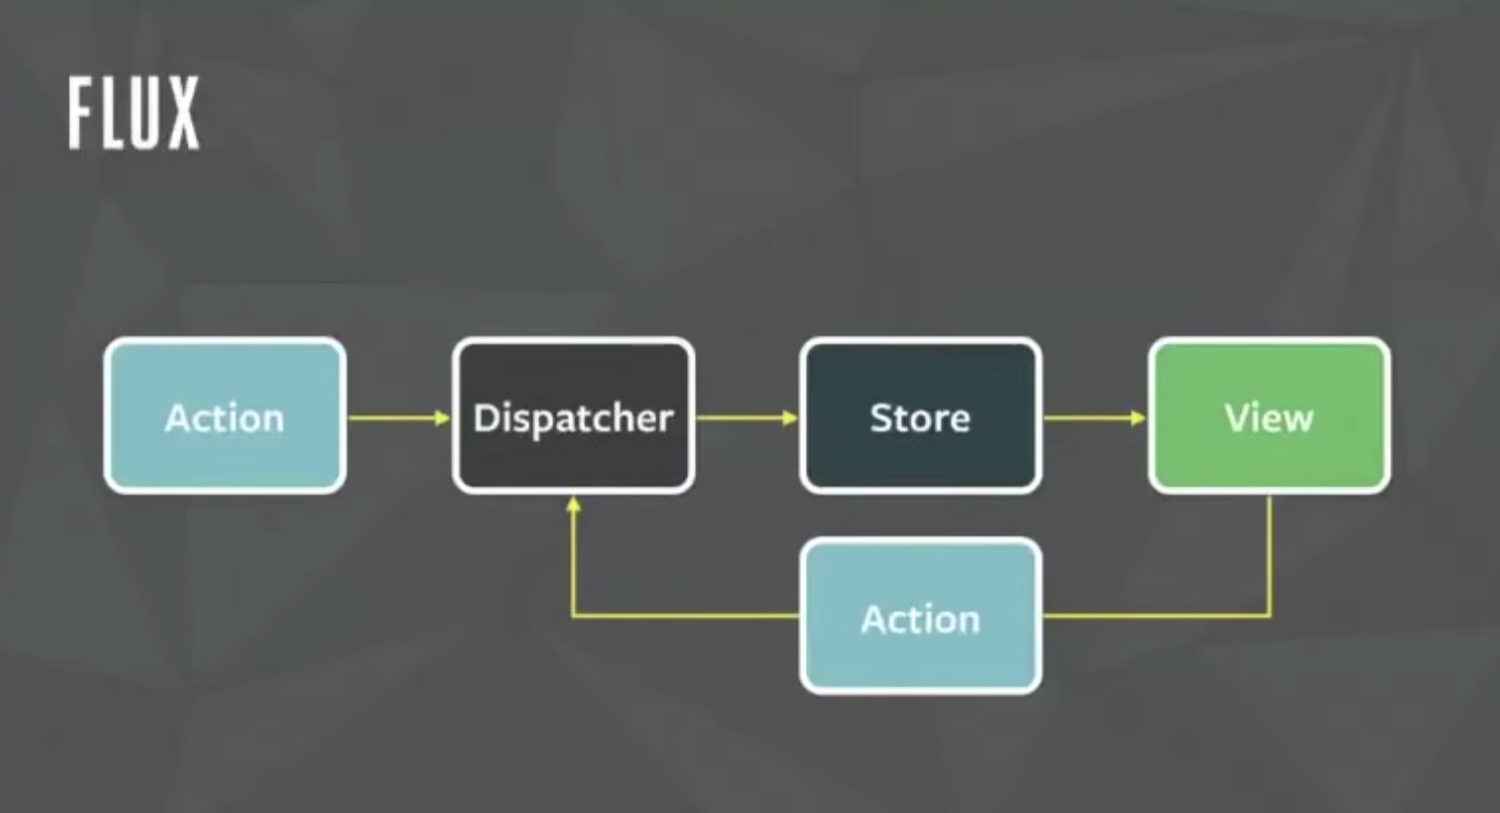
Flux Architecture
Hacker Way: Rethinking Web App Development at Facebook

Slide 13
Redux
“Redux is a predictable state container for JavaScript apps.”

Slide 14
Redux – An Implementation of Flux
In 2015, Dan Abramov released a new implementation for Flux – Redux.
Redux store is an object consist of multiple reducers.
Redux = Flux + Reducers

Slide 15
ReduxArchitecture
Store
Action
Dispatcher
Reducer
Reducer
View
Reducer
Action

Slide 16


Slide 17
How Facebook were using MVC ?
MVC at Facebook
MVC
Model
Controller
View

Slide 18

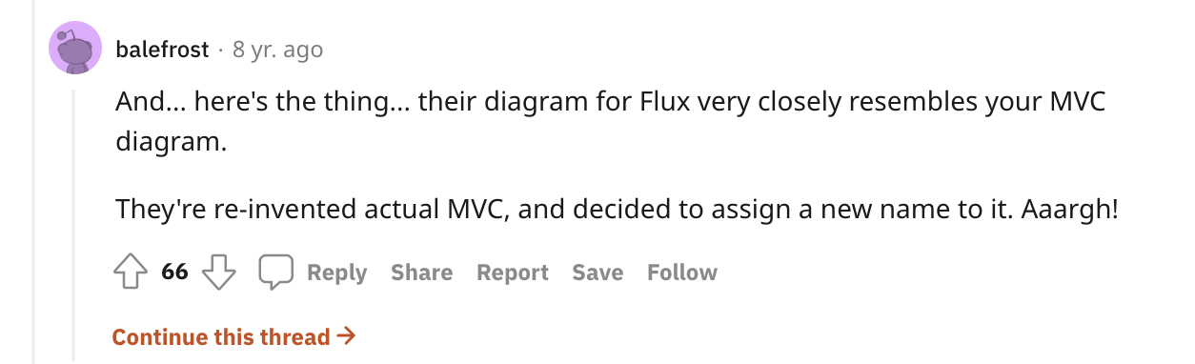
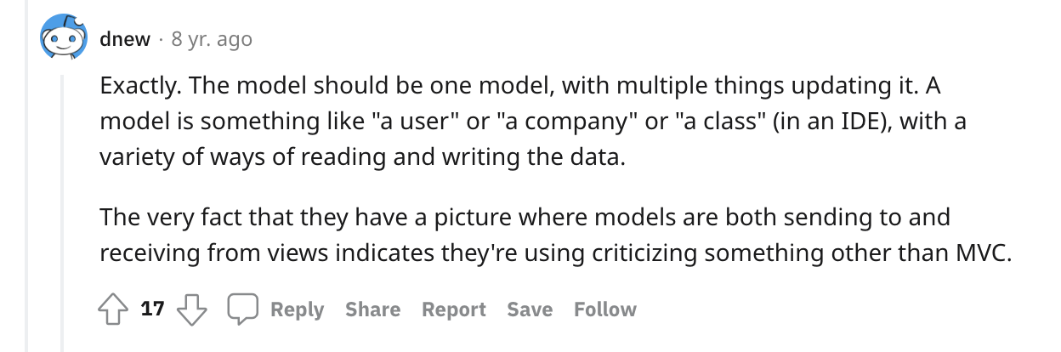
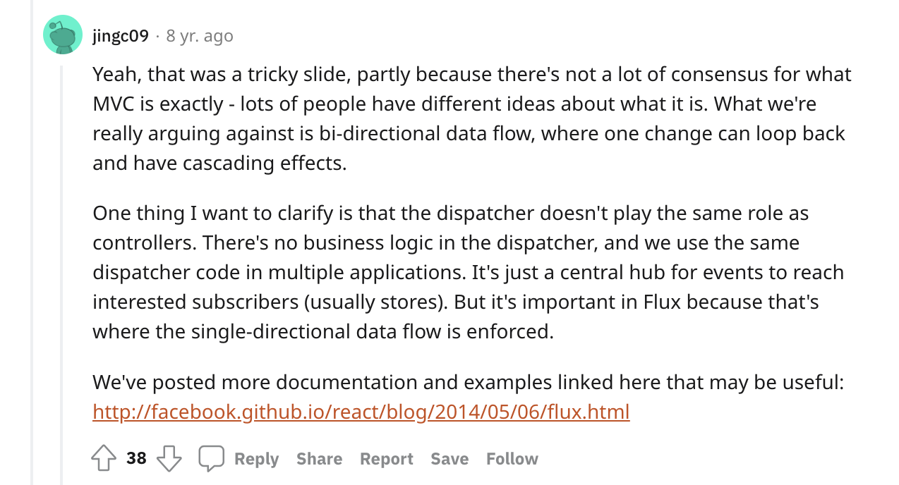
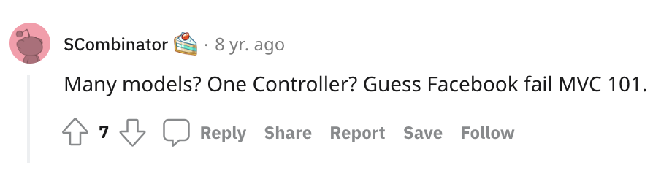
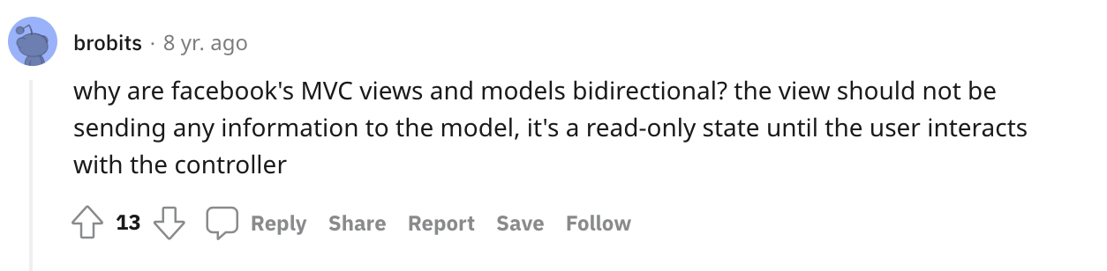

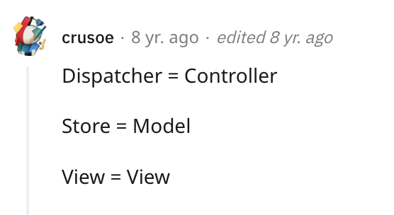

Slide 19
Usefull links
Hacker Way: Rethinking Web App Development at Facebook
https://www.martinfowler.com/eaaDev/uiArchs.html#Model-view-presentermvp
http://ceur-ws.org/Vol-610/paper11.pdf
https://www.infoq.com/news/2014/05/facebook-mvc-flux/
https://www.reddit.com/r/programming/comments/25nrb5/comment/chj2fzc/
https://stackoverflow.com/questions/2056/what-are-mvp-and-mvc-and-what-is-the-difference
https://github.com/facebook/flux/tree/main/examples/flux-concepts
https://youtube.com/watch?v=xsSnOQynTHs

